Slide 1

CSE 470/598 Meshes
Ross Maciejewski
rmacieje@asu.edu

Slide 2
Disclaimer
These slides can only be used as study material for the class 470 at ASU
The slides cannot be distributed or used for another purpose

Slide 3
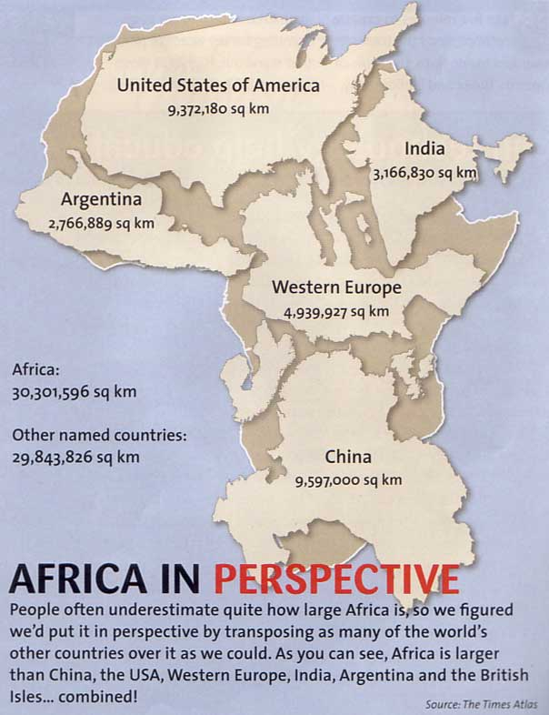

Slide 4
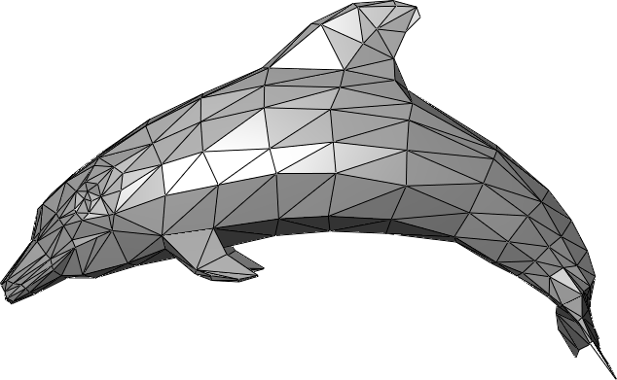
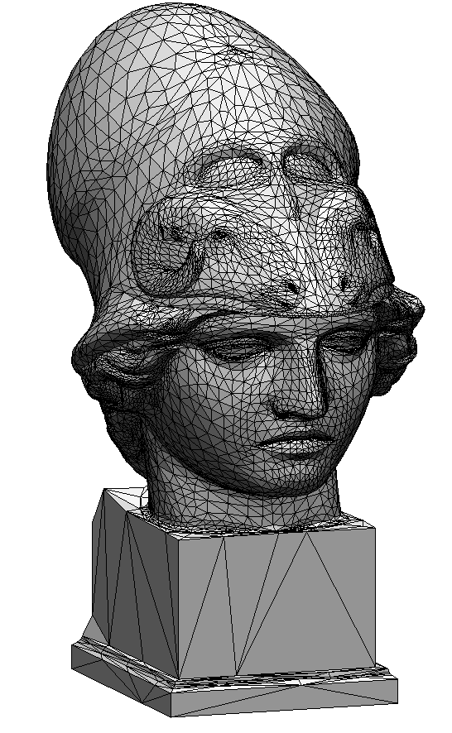
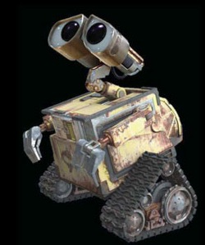
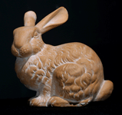
Introduction
Goal
How to represent a 3D Model
Options
1D – Points
2D – Lines
3D – Triangles
Triangle meshes
Basic primitive for storing “faces” of an object
Hardware is optimized for triangle processing

Slide 5
Vector Library
A vector (and matrix) library is necessary for all graphics programming!
How to get it:
You can implement it yourself
You can use popular ones on the internet

Slide 6
Vector Library
//-- Class for a 3d float vector
class V3f
{
public:
V3f(float x, float y, float z) {v[0] = x; v[1] = y; v[2] = z;}
V3f() {v[0] = 0; v[1] = 0; v[2] = 0;}
V3f AddVector(const V3f& a);
V3f SubtractVector(const V3f& a);
V3f MultiplyWithScalar(float t);
V3f Normalize();
V3f Crossproduct(const V3f& a);
float DotProduct(const V3f& a);
float length(); // Length of the vector
public: // or private?
float v[3];
};

Slide 7
Vector Library
//-- for example
V3f V3f::AddVectors(const V3f& a)
{
V3f ReturnVector;
ReturnVector.v[0] = v[0] + a.v[0];
ReturnVector.v[1] = v[1] + a.v[1];
ReturnVector.v[2] = v[2] + a.v[2];
return ReturnVector;
}

Slide 8
Vector Library with Algebraic Operators
//-- Class for a 3d float vector
class V3f
{
public:
V3f(float x, float y, float z) {v[0] = x; v[1] = y; v[2] = z;}
V3f() {v[0] = 0; v[1] = 0; v[2] = 0;}
V3f operator+ (const V3f& a); // AddVector(const V3f& a);
V3f operator- (const V3f& a); // SubtractVector(const V3f& a);
V3f operator* (float t); // MultiplyWithScalar(float t);
V3f Normalize();
V3f operator% (const V3f& a); // Crossproduct(const V3f& a);
float operator^ (const V3f& a); // DotProduct(const V3f& a);
float length(); // Length of the vector
public:
float v[3];
};

Slide 9
Vector Library
ilmBase
Download from: http://www.openexr.com/downloads.html
Also Available from MyASU.

Slide 10
Why Choose This Library:
Include many other useful feature such as multi-threading.
Generic programming style (uses templates).
Notes:
10

Slide 11
Setup the Library
Put the whole directory IlmBase in the same directory where your own cpp files live.
In project properties->C/C++->General->Additional Include Directories, add this path: .\ilmbase\inc\imath
Include imathvec.h in your cpp files.
Notes:
11

Slide 12
Declare New 3D vector
typedef Vec3<float> Vec3f;
/* this makes the following declaration easier to write*/
Vec3f v0; // instead of Vec3<float> v0;
Vec3f v1;
Vec3f v2;

Slide 13
Set Values
v0.setValue(-1,0,0); //Ok
v1.setValue(1.0,0.0,0.0); //Ok
v1.setValue(1.0,0,0); /* type mismatch, will not compile*/
v2.setValue(0,1,0); //Ok
y
v2
v0
v1
x

Slide 14
Get Values
v1.x //returns the first component’s value.
v1.y //returns the second component’s value.
v1.z //returns the third component’s value.

Slide 15
Find Value Range
/* print out the range of float values that can be represented in computer*/
printf("the smallest float value is: %e\n",v1.baseTypeMin());
printf("the largest float value is: %e\n",v1.baseTypeMax());
Output:
the smallest float value is: -3.402823e+038
the largest float value is: 3.402823e+038

Slide 16
Dot Product
//dot product for two vectors:
float dotproduct = v1.dot(v2);
printf("the dot product of v1 and v2 is %f\n",dotproduct);
Output:
the dot product of v1 and v2 is 0.000000
Notes:
16

Slide 17
Cross Product
//cross proudct for two vectors:
Vec3f v3 = v1.cross(v2);
printf("the product of v1 and v2 are vector (%.2f,%.2f,%.2f)\n", v3.x,v3.y,v3.z);

Slide 18
Test Equality
v1.setValue(100.0,100.0,100.0);
v2 = v1;
v2+= Vec3f(1,0,0);
vector 1 is 100.00, 100.00 , 100.00
vector 2 is 101.00, 100.00 , 100.00
v1 == v2
will return false.

Slide 19
Test Equality (Cond.)
v1.equalWithAbsError(v2,2) will return true.
v1.equalWithRelError(v2,0.02) will return true also.
For i = 0, 1 and 2, |v1_{i}- v2_{i}| <= 2.
For i = 0,1 and 2, |v1_{i}- v2_{i}| <= 0.02*|v1_{i}|.

Slide 20
Two Advanced Examples:
Calculate the area of a triangle.
Implement the gluLookat() function.

Slide 21
Calculate the Area of a Triangle
/* a simple function calculate the area of a triangle given three vertices*/
template<class T> T triangle_area(const Vec3<T> & v1, const Vec3<T> & v2, const Vec3<T> & v3){
Vec3<T> AB = v2-v1, AC = v3-v1;
return (AB.cross(AC)).length()/2;}

Slide 22
Area of A Triangle, Example:
//calculate the area of the triangle with vertex v0,v1,v2
float area = triangle_area(v0,v1,v2);
printf("the area of the triangle is %.4f\n", area);

Slide 23
Implement gluLookAt

Slide 24
Standard Template Library
Father: Alexander Stepanov.
Year of Birth: 1993 A.D.
Birth Place: HP lab.
Membership: ANSI/ISO C++ standard.
Notes:
24

Slide 25
STL Resources
Two books:
The C++ Standard Library: A Tutorial and Reference by Nicolai M. Josuttis (Hardcover - Aug 22, 1999)
Effective STL: 50 Specific Ways to Improve Your Use of the Standard Template Library (Addison-Wesley Professional Computing Series) by Scott Meyers (Paperback - Jun 16, 2001)
One website:
http://www.sgi.com/tech/stl/
25
Notes:
25

Slide 26
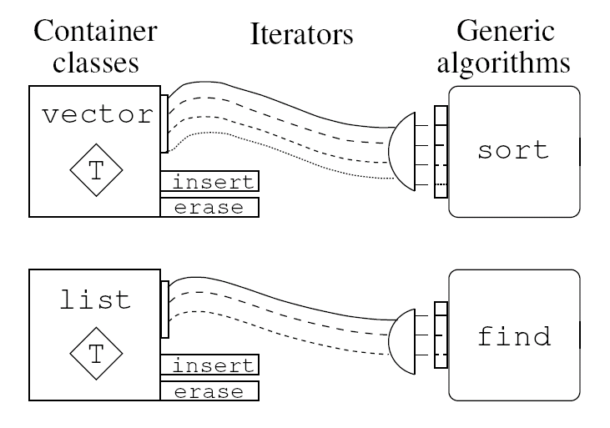
STL Components
Container
Iterator
Algorithm
Adaptor
Notes:
26

Slide 27
STL Vector Versus C++ Dynamic Array
Automatically resize itself.
Do not need to be explicitly deleted after used.
C++ Array:
int * a = new int[10];
for(i = 0;i<10;i ++)
a[i] = i;
delete[] a;
STL vector:
Vector<int> a;
for(i = 0;i<10;i ++)
a.push_back(i);
//clean itself when out of scope
Notes:
27

Slide 28
Vector Member Functions
Informative Member Functions
vector::front - Returns reference to first element of vector.
vector::back - Returns reference to last element of vector.
vector::size - Returns number of elements in the vector.
vector::empty - Returns true if vector has no elements.
vector::capacity - Returns current capacity (allocated memory) of vector
Notes:
28

Slide 29
Vector Member Functions
vector::insert - Inserts elements into a vector (single & range), shifts later elements up. O(n) time.
vector::push_back - Appends (inserts) an element to the end of a vector, allocating memory for it if necessary. O(1) time.
vector::erase - Deletes elements from a vector (single & range), shifts later elements down. O(n) time.
vector::pop_back - Erases the last element of the vector, O(1) time. Does not usually reduce the memory overhead of the vector O(1) time.
vector::clear - Erases all of the elements. (For most STL implementations this is O(1) time and does not reduce capacity)

Slide 30
Mesh Structure
typedef Vec3<float> Vec3f;
typedef Vec2<float> Vec2f;
struct Mesh
{
vector<Vec3f> m_v; // array of vertices
vector<Vec3f> m_n; // array of normals
vector<Vec2f> m_texc; // array of texture coordinates; assume using 2d textures
vector<int> m_vi; // vertex indices
vector<int> m_ni; // normal indices
vector<int> m_ti; // texcoord indices
};

Slide 31
Terms
Triangular mesh
Triangle mesh
Triangular irregular networks (TINs)
Popular in the GIS community

Slide 32
Triangle Mesh
Not just a ‘triangle soup’
Mesh represents a surface
Neighboring triangles
Vertices
Edges
Color / Texture
Mesh processing is more efficient than processing unrelated triangles

Slide 33
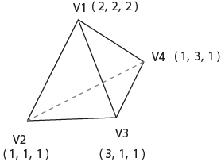

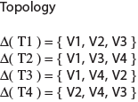
Mesh Properties
Geometry
Vertex positions
Model coordinate space
Spatial Information
Topology
Neighbor information
Triangle-edge information
How are the individual triangles connected?
Additional Information
Per vertex, edge, and triangle

Slide 34
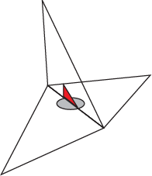
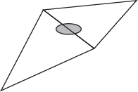
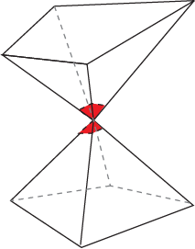
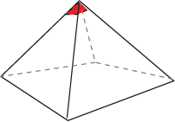
Mesh Topology
A formal model of the surface represented by the mesh
Manifold surface (2D)
A surface that ‘looks like’ a 2D surface at every point on the mesh
Is locally ‘flat’ everywhere
Verification rules
Every edge is shared by two triangles
Every vertex has a single, complete loop of triangles around it

Slide 35
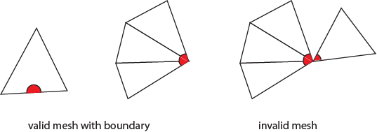
Practical Scenario - Boundaries
Boundaries are allowed
Relaxed conditions
Every edge is used by either one or two triangles
Every vertex connects to a single edge-connected set of triangles

Slide 36
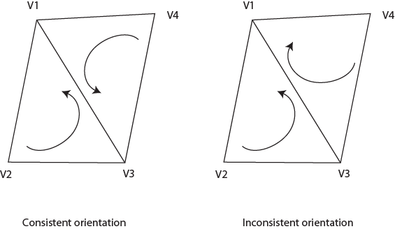
Mesh Orientation
Ability to distinguish ‘front’ and ‘back’ faces
Efficient rendering
Many rendering effects treat front and back faces separately
Vertex order
Counterclockwise or clockwise
Adjacent triangles should be correctly oriented

Slide 37
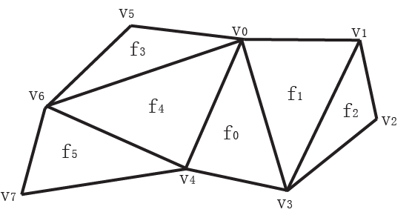
Triangle Soup
Array for Vertices
3 floats per vertex
Three subsequent vertices form a triangle
Vertex | Coordinates
V₀ | x = … y = … z = …
V₄ | x = … y = … z = …
V₃ | x = … y = … z = …
V₀ | x = … y = … z = …
V₃ | x = … y = … z = …
V₁ | x = … y = … z = …
V₁ | x = … y = … z = …
V₃ | x = … y = … z = …

Slide 38
Triangle Soup
Advantages
super simple
Disadvantages
no connectivity
storage requirements
…

Slide 39
Triangle Soup: Rendering Example
//-- attention: STL uses Namespace
std::vector<V3f> VertexArray;
VertexArray.push_back( V3f(0, 0, 0) );
VertexArray.push_back( V3f(1, 0, 0) );
VertexArray.push_back( V3f(0, 1, 0) );
VertexArray.push_back( V3f(1, 1, 0) );
glBegin(GL_TRIANGLE_STRIP);
glNormal3f(0.0, 0.0, 1.0);
for(int i = 0; i < VertexArray.size(); i++)
glVertex3f( VertexArray[i].v[0], VertexArray[i].v[1], VertexArray[i].v[2]);
glEnd();

Slide 40
Indexed Mesh (Simple)
Vertex | Coordinates
V₀ | x = … y = … z = …
V₁ | x = … y = … z = …
V₂ | x = … y = … z = …
V₃ | x = … y = … z = …
V₄ | x = … y = … z = …
V₅ | x = … y = … z = …
V₆ | x = … y = … z = …
V₇ | x = … y = … z = …
Array for Vertices
3 floats per vertex
Array for Faces
3 integers per face
Face | Indices
f₀ | 0, 4, 3
f₁ | 0, 3, 1
f₂ | 1, 3, 2
f₃ | 0, 5, 6
f₄ | 0, 6, 4
f₅ | 4, 6, 7

Slide 41
Indexed Mesh: Rendering Example
Lets make a model with indices:
std::vector<V3f> VertexArray;
std::vector<int> IndexArray;
VertexArray.push_back( V3f(0, 0, 0) );
VertexArray.push_back( V3f(1, 0, 0) );
VertexArray.push_back( V3f(0, 1, 0) );
VertexArray.push_back( V3f(1, 1, 0) );
VertexArray.push_back( V3f(0.5, 1.5, 0) );
// face 0
IndexArray.push_back(0); IndexArray.push_back(1); IndexArray.push_back(2);
// face 1
IndexArray.push_back(2); IndexArray.push_back(1); IndexArray.push_back(3);
// face 2
IndexArray.push_back(2); IndexArray.push_back(3); IndexArray.push_back(4);
glBegin(GL_TRIANGLES);
glNormal3f(0.0, 0.0, 1.0);
// NOTE index i has to be adjusted
for(int i = 0; i < IndexArray.size()/3; i+=3)
{
glVertex3f( VertexArray[ IndexArray[i+0]].v[0],
VertexArray[ IndexArray[i+0]].v[1],
VertexArray[ IndexArray[i+0]].v[2]);
glVertex3f( VertexArray[ IndexArray[i+1]].v[0],
VertexArray[ IndexArray[i+1]].v[1],
VertexArray[ IndexArray[i+1]].v[2]);
glVertex3f( VertexArray[ IndexArray[i+2]].v[0],
VertexArray[ IndexArray[i+2]].v[1],
VertexArray[ IndexArray[i+2]].v[2]);
}
glEnd();

Slide 42
Indexed Mesh: Triangle area computation
std::vector<V3f> VertexArray;
std::vector<int> IndexArray;
VertexArray.push_back( V3f(0, 0, 0) );
VertexArray.push_back( V3f(1, 0, 0) );
VertexArray.push_back( V3f(0, 1, 0) );
VertexArray.push_back( V3f(1, 1, 0) );
VertexArray.push_back( V3f(0.5, 1.5, 0) );
// face 0
IndexArray.push_back(0); IndexArray.push_back(1); IndexArray.push_back(2);
// face 1
IndexArray.push_back(2); IndexArray.push_back(1); IndexArray.push_back(3);
// face 2
IndexArray.push_back(2); IndexArray.push_back(3); IndexArray.push_back(4);
for( int i = 0;
i < IndexArray.size()/3;
i+=3)
{
V3f v0 = VertexArray[IndexArray[i+1]] - VertexArray[IndexArray[i+0]];
V3f v1 = VertexArray[IndexArray[i+2]] - VertexArray[IndexArray[i+0]];
V3f v = v0%v1; // cross product
float area = v.length() / 2;
}

Slide 43
Extending with other Attributes
How to extend with per vertex, per face, and per edge attributes?
There are many possible options, we will just look at a few

Slide 44
Extending to Vertex Attributes
Option 1: store vertex attributes (normals, texture coordinates, … ) together with a vertex
Advantages: fairly clean
Disadvantages: if vertex attributes differ → vertex has to be split
Option 2: allow for different vertex attributes for each occurrence of a triangle
Advantages: very flexible
Disadvantages: brute force / redundant

Slide 45
Per Face Normals (Option 2)
Normal | Coordinates
n₀ | x = … y = … z = …
n₁ | x = … y = … z = …
n₂ | x = … y = … z = …
n₃ | x = … y = … z = …
n₄ | x = … y = … z = …
n₅ | x = … y = … z = …
n₀
v₁
n₄
v₅
v₀
n₁
n₃
n₂
v₂
v₆
v₄
Face | Indices
f₀ | 0, 4, 3
f₁ | 0, 3, 1
f₂ | 1, 3, 2
f₃ | 0, 5, 6
f₄ | 0, 6, 4
f₅ | 4, 6, 7
Normal Index | Indices
ni₀ (f₀) | 2, 2, 2
ni₁ (f₁) | 0, 0, 0
ni₂ (f₂) | 1, 1, 1
ni₃ (f₃) | 4, 4, 4
ni₄ (f₄) | 3, 3, 3
ni₅ (f₅) | 5, 5, 5
v₇
v₃
n₅
Note redundancy in the Normal index table!

Slide 46
Per Vertex Normals (Option 2)
n₁
Normal | Coordinates
n₀ | x = … y = … z = …
n₁ | x = … y = … z = …
n₂ | x = … y = … z = …
n₃ | x = … y = … z = …
n₄ | x = … y = … z = …
n₅ | x = … y = … z = …
n₆ | x = … y = … z = …
n₇ | x = … y = … z = …
n₅
n₀
v₁
n₂
v₅
v₀
v₂
n₆
n₄
n₃
v₆
v₄
v₇
Face | Indices
f₀ | 0, 4, 3
f₁ | 0, 3, 1
f₂ | 1, 3, 2
f₃ | 0, 5, 6
f₄ | 0, 6, 4
f₅ | 4, 6, 7
Normal Index | Indices
f₀ | 0, 4, 3
f₁ | 0, 3, 1
f₂ | 1, 3, 2
f₃ | 0, 5, 6
f₄ | 0, 6, 4
f₅ | 4, 6, 7
v₃
n₇
Note redundancy (face indices = normal indices)!

Slide 47
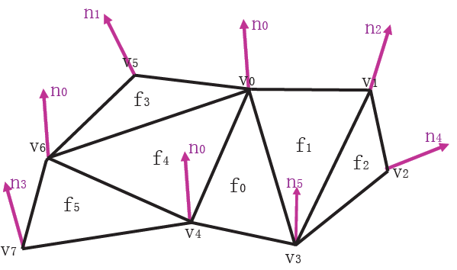
Per Vertex Normals (Compressed)
Different vertices can share the same normal
E.g. normal compression with vector quantization
Normal | Coordinates
n₀ | x = … y = … z = …
n₁ | x = … y = … z = …
n₂ | x = … y = … z = …
n₃ | x = … y = … z = …
n₄ | x = … y = … z = …
n₅ | x = … y = … z = …
Face | Indices
f₀ | 0, 4, 3
f₁ | 0, 3, 1
f₂ | 1, 3, 2
f₃ | 0, 5, 6
f₄ | 0, 6, 4
f₅ | 4, 6, 7
Normal Index | Indices
ni₀ (f₀) | 0, 0, 5
ni₁ (f₁) | 0, 5, 2
ni₂ (f₂) | 2, 5, 4
ni₃ (f₃) | 0, 1, 0
ni₄ (f₄) | 0, 0, 0
ni₅ (f₅) | 0, 0, 3

Slide 48
Indexed Mesh + Normals + TextureCoordinates
Vertex | Coordinates
V₀ | x = … y = … z = …
V₁ | x = … y = … z = …
V₂ | x = … y = … z = …
V₃ | x = … y = … z = …
V₄ | x = … y = … z = …
V₅ | x = … y = … z = …
V₆ | x = … y = … z = …
V₇ | x = … y = … z = …
Normal | Coordinates
n₀ | x = … y = … z = …
n₁ | x = … y = … z = …
n₂ | x = … y = … z = …
n₃ | x = … y = … z = …
n₄ | x = … y = … z = …
n₅ | x = … y = … z = …
Texture | Coordinates
t₀ | s = … t = …
t₁ | s = … t = …
t₂ | s = … t = …
t₃ | s = … t = …
t₄ | s = … t = …
t₅ | s = … t = …
Face | Indices
f₀ | 0, 4, 3
f₁ | 0, 3, 1
f₂ | 1, 3, 2
f₃ | 0, 5, 6
f₄ | 0, 6, 4
f₅ | 4, 6, 7
Normal Index | Indices
ni₀ (f₀) | 0, 0, 5
ni₁ (f₁) | 0, 5, 2
ni₂ (f₂) | 2, 5, 4
ni₃ (f₃) | 0, 1, 0
ni₄ (f₄) | 0, 0, 0
ni₅ (f₅) | 0, 0, 3
Texture | Indices
ti₀ | 0, 1, 2
ti₁ | 1, 2, 3
ti₂ | 3, 4, 5
ti₃ | 3, 4, 5
ti₄ | 3, 4, 5
ti₅ | 5, 1, 2

Slide 49
Per-Vertex Normals + Sharp Features
Normal | Coordinates
n₀ | x = … y = … z = …
n₁ | x = … y = … z = …
n₂ | x = … y = … z = …
n₃ | x = … y = … z = …
n₄ | x = … y = … z = …
n₅ | x = … y = … z = …
n₆ | x = … y = … z = …
n₇ | x = … y = … z = …
n₈ | x = … y = … z = …
n₉ | x = … y = … z = …
n₀
n₅
n₉
v₁
n₂
v₅
v₀
v₂
n₆
n₈
n₄
n₃
v₆
v₄
v₇
v₃
n₇
Face | Indices
f₀ | 0, 4, 3
f₁ | 0, 3, 1
f₂ | 1, 3, 2
f₃ | 0, 5, 6
f₄ | 0, 6, 4
f₅ | 4, 6, 7
Normal Index | Indices
f₀ | 0, 4, 3
f₁ | 0, 3, 1
f₂ | 1, 3, 2
f₃ | 0, 5, 6
f₄ | 9, 6, 8
f₅ | 4, 6, 7

Slide 50
Mesh Structure – Example Code
typedef Vec3<float> Vec3f;
typedef Vec2<float> Vec2f;
struct Mesh
{
vector<Vec3f> m_v; // array of vertices
vector<Vec3f> m_n; // array of normals
vector<Vec2f> m_texc; // array of texture coordinates; assume using 2d textures
vector<int> m_vi; // vertex indices
vector<int> m_ni; // normal indices
vector<int> m_ti; // texcoord indices
};
50

Slide 51
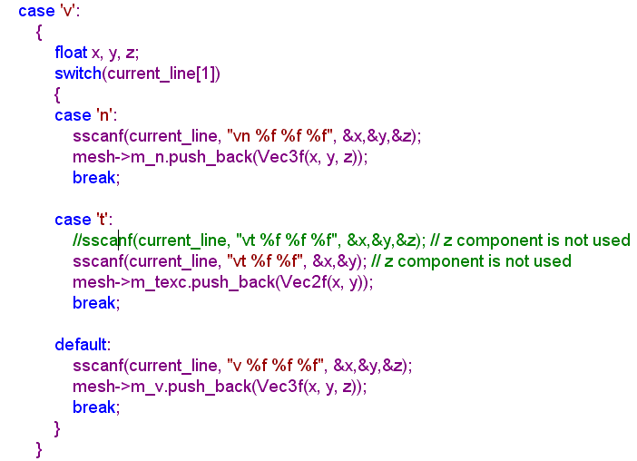
Read In the Mesh Structure
51

Slide 52
Draw The Mesh
vector<int>& vi = model->m_vi;
vector<Vec3f>& v = model->m_v;
glBegin(GL_TRIANGLES);
for(unsigned int i = 0;i < vi.size();i++)
{
Vec3f offset = (v[vi[i]] - bbxCenter);;
glColor3f(fabs(sin(offset.x)), fabs(cos(offset.y)), fabs(offset.z));
glVertex3fv(&v[vi[i]].x);
}
glEnd();
52

Slide 53
Bounding Box
53

Slide 54
Tips: GLUT predefined objects
For example: glutSolidSphere (1.0, 20, 16); glutSolidSphere( radius, slices, stacks);
Why is this so great? Objects come with predefined per vertex normals Great to start out without tedious normal computation!
Other similar objects are available
You can use the objects for debugging but not for your final submitted projects!

Slide 55
Indexed Triangle Mesh Disadvantages
Treat each triangle separately
Calculate area example
Neighborhood information is not available
Given a triangle, what are its three adjacent triangles?
Given an edge, which two triangles share it?
Given a vertex, which faces share it?
Given a vertex, which edges share it?
To store complete topology of a mesh, three basic entities need to be stored
Triangles, Edges and Vertices

Slide 56
Mesh Connectivity Data Structure
Triangle
3 Pointer to Vertices
3 Pointer to Edges
Edge
2 Pointer to Vertices
2 Pointer to Triangles
Vertex (the problem)
Array of Pointers to triangles (variable length)
Array of Pointers to edges (variable length)
Redundant information storage

Slide 57
Efficiency Considerations
Vertex
Variable length members
Not efficient mechanism for storage and access
Triangle
Fixed length member arrays
Does not scale to meshes with arbitrary sided polygons
Edge
Exactly two vertex references
Exactly two face references
Efficient lookup scheme (constant time lookup for faces and vertices)

Slide 58
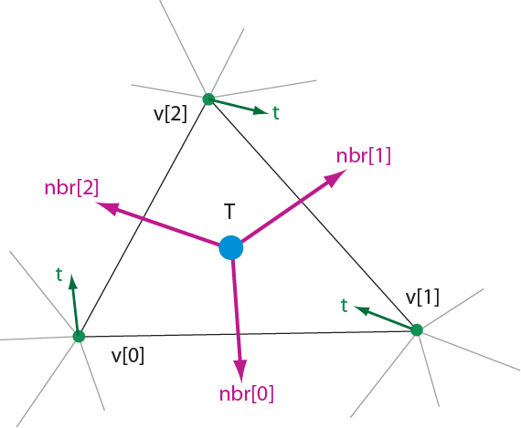
Triangle – Neighbor Structure
Triangle {
// neighboring triangles
TriangleP nbr[3]; // 3 Pointer to Neighboring Triangles;
VertexP v[3]; // 3 Pointer to the three triangle vertices
}
Vertex {
... // any per vertex data
TriangleP t; // one random incident triangle
}

Slide 59
Implementation
std::vector<V3f> VertexArray;
std::vector<int> IndexArray;
std::vector<V3i> NbrArray; // to store the “nbr” members
std::vector<int> TriArray; // to store the “t” member for each vertex
Pseudo-code
void findAllTrianglesForVertex( int vIndex )
{
int t = TriArray[ vIndex ];
do
{
// Find the triangle that contains this vertex
find k such that ( t.v[k] == vIndex );
// The next triangle is the kth neighbor of t
t = TriArray[ NbrArray[t][k] ];
} while( t != TriArray[ vIndex ] );
}

Slide 60
Vertex-based Meshes
Advantages
Simple to implement
Vertex connectivity can be found in constant time
Can be generalized for non-manifold meshes
Disadvantages
Triangle connectivity is not readily available
Have to walk through a loop every time
Solution: Edge based mesh representation

Slide 61
Edge based Mesh Representations
Winged-Edge Structure
Half-Edge Structure
Use edges to store connectivity information
Two vertex and two face references needed in simplest case
Allows easy access to a random edge in the edge list
Can be generalized to polygonal meshes

Slide 62
Winged edge structure
Edge – basic topological unit
Edge members
Two pointers to edge vertices
Two pointers to left and right faces
Two edge pointers to walk around the faces in consistent winding order
Next Edge (lnext, rnext)
Previous Edge (lprev, rprev)
Vertex and Face
Store One edge pointer

Slide 63
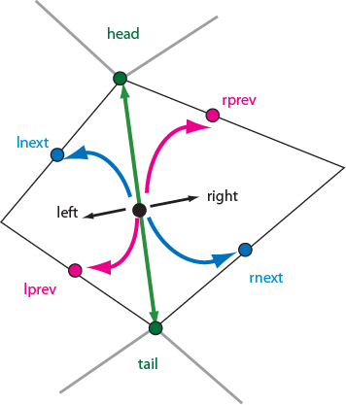
Data Structure
Edge {
EdgeP lprev, rprev;
EdgeP lnext, rnext;
VertexP head, tail;
TriangleP left, right;
}
Triangle {
EdgeP e; // random adjecent edge
}
Vertex {
EdgeP e; // random incident edge
}

Slide 64
Topological Queries
EdgesOfVertex( v )
{
e = v.e;
do {
if( e.tail == v )
e = e.lprev;
else
e = e.rprev;
// print edge info
printEdge(e);
} while( e != v.e );
}
EdgesOfFace( f )
{
e = f.e;
do {
if( e.left == f )
e = e.lnext;
else
e = e.rnext;
// print edge info
printEdge(e);
} while( e != f.e );
}
Orientation check required for each iteration
(highlighted code)
Solution: Half-edge Structure

Slide 65
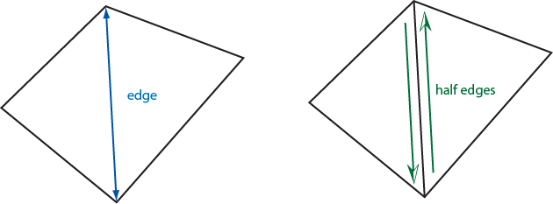
Half-edge Structure
Removes unelegant code portion
Constant orientation check
More memory required
2 half-edges per edge in the mesh
Faster topological querying
No special case checking
Boundaries handled with minimal code change

Slide 66
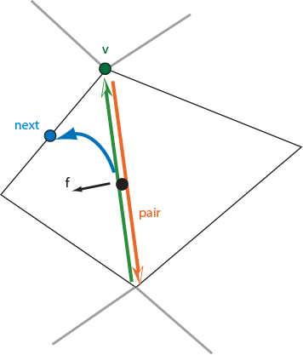
Half Edge Data Structures
Hedge {
HedgeP pair, next;
VertexP v;
TriangleP f;
}
Triangle {
HedgeP h; // random h-edge
}
Vertex {
HedgeP h; // random h-edge
}

Slide 67
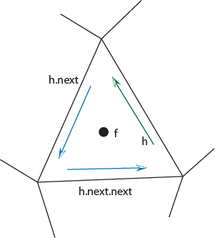
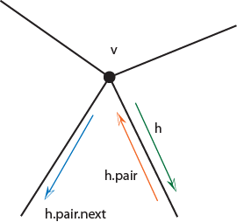
Topological Queries
EdgesOfVertex( v )
{
h = v.h;
do {
h = h.pair.next;
// print edge info
printEdge(h);
} while( h != v.h );
}
EdgesOfFace( f )
{
h = f.h;
do {
h = h.next;
// print edge info
printEdge(h);
} while( h != f.h );
}

Slide 68
Representing a Mesh
Consider a mesh
There are 8 nodes and 12 edges
5 interior polygons
6 interior (shared) edges
Each vertex has a location v_{i} = (x_{i} y_{i} z_{i})
e₂
v₅
v₆
e₃
e₉
e₈
v₈
v₄
e₁
e₁₁
e₁₀
e₇
v₇
e₄
v₁
v₂
e₁₂
e₆
v₃
e₅

Slide 69
Simple Representation
Define each polygon by the geometric locations of its vertices
Leads to OpenGL code such as
Inefficient and unstructured
Consider moving a vertex to a new location
Must search for all occurrences
vertex[i] = vec3(x1, x1, x1);
vertex[i+1] = vec3(x6, x6, x6);
vertex[i+2] = vec3(x7, x7, x7);
i+=3;

Slide 70
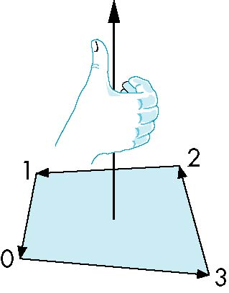
Inward and Outward Facing Polygons
The order {v₁, v₆, v₇} and {v₆, v₇, v₁} are equivalent in that the same polygon will be rendered by OpenGL but the order {v₁, v₇, v₆} is different
The first two describe outwardly
facing polygons
Use the right-hand rule =
counter-clockwise encirclement
of outward-pointing normal
OpenGL can treat inward and
outward facing polygons differently

Slide 71
Geometry vs Topology
Generally it is a good idea to look for data structures that separate the geometry from the topology
Geometry: locations of the vertices
Topology: organization of the vertices and edges
Example: a polygon is an ordered list of vertices with an edge connecting successive pairs of vertices and the last to the first
Topology holds even if geometry changes

Slide 72
Vertex Lists
Put the geometry in an array
Use pointers from the vertices into this array
Introduce a polygon list
x₁ y₁ z₁
x₂ y₂ z₂
x₃ y₃ z₃
x₄ y₄ z₄
x₅ y₅ z_{5.}
x₆ y₆ z₆
x₇ y₇ z₇
x₈ y₈ z₈
v₁
v₇
v₆
P1
P2
P3
P4
P5
v₈
v₅
v₆
topology
geometry

Slide 73
Shared Edges
Vertex lists will draw filled polygons correctly but if we draw the polygon by its edges, shared edges are drawn twice
Can store mesh by edge list

Slide 74
Edge List
e₂
v₅
x₁ y₁ z₁
x₂ y₂ z₂
x₃ y₃ z₃
x₄ y₄ z₄
x₅ y₅ z_{5.}
x₆ y₆ z₆
x₇ y₇ z₇
x₈ y₈ z₈
v₆
e₃
e1
e2
e3
e4
e5
e6
e7
e8
e9
v1
v6
e₉
e₈
v₈
e₁
e₁₁
e₁₀
e₇
v₇
e₄
v₁
v₂
e₁₂
e₆
v₃
e₅
Note polygons are
not represented

Slide 75
Modeling a Cube
Model a color cube for rotating cube program
Define global arrays for vertices and colors
GLfloat vertices[][3] = {{-1.0,-1.0,-1.0},{1.0,-1.0,-1.0},
{1.0,1.0,-1.0}, {-1.0,1.0,-1.0}, {-1.0,-1.0,1.0},
{1.0,-1.0,1.0}, {1.0,1.0,1.0}, {-1.0,1.0,1.0}};
GLfloat colors[][3] = {{0.0,0.0,0.0},{1.0,0.0,0.0},
{1.0,1.0,0.0}, {0.0,1.0,0.0}, {0.0,0.0,1.0},
{1.0,0.0,1.0}, {1.0,1.0,1.0}, {0.0,1.0,1.0}};

Slide 76
Drawing a triangle from a list of indices
Draw a triangle from a list of indices into the array vertices and assign a color to each index
void triangle(int a, int b, int c, int d)
{
vcolors[i] = colors[d];
position[i] = vertices[a];
vcolors[i+1] = colors[d]);
position[i+1] = vertices[a];
vcolors[i+2] = colors[d];
position[i+2] = vertices[a];
i+=3;
}

Slide 77
Draw cube from faces
void colorcube( )
{
quad(0,3,2,1);
quad(2,3,7,6);
quad(0,4,7,3);
quad(1,2,6,5);
quad(4,5,6,7);
quad(0,1,5,4);
}
5
6
2
1
7
4
0
3
Note that vertices are ordered so that
we obtain correct outward facing normals

Slide 78
Efficiency
The weakness of our approach is that we are building the model in the application and must do many function calls to draw the cube
Drawing a cube by its faces in the most straight forward way used to require
6 glBegin, 6 glEnd
6 glColor
24 glVertex
More if we use texture and lighting

Slide 79
Vertex Arrays
OpenGL provided a facility called vertex arrays that allows us to store array data in the implementation
Six types of arrays were supported initially
Vertices
Colors
Color indices
Normals
Texture coordinates
Edge flags
Now vertex arrays can be used for any attributes

Slide 80
Old Style Initialization
Using the same color and vertex data, first we enable
glEnableClientState(GL_COLOR_ARRAY);
glEnableClientState(GL_VERTEX_ARRAY);
Identify location of arrays
glVertexPointer(3, GL_FLOAT, 0, vertices);
glColorPointer(3, GL_FLOAT, 0, colors);
data array
3d arrays
stored as floats
data contiguous

Slide 81
Mapping indices to faces
Form an array of face indices
Each successive four indices describe a face of the cube
Draw through glDrawElements which replaces all glVertex and glColor calls in the display callback
GLubyte cubeIndices[24] = {0,3,2,1,2,3,7,6
0,4,7,3,1,2,6,5,4,5,6,7,0,1,5,4};

Slide 82
Drawing the cube
Old Method:
Problem is that although we avoid many function calls, data are still on client side
Solution:
no immediate mode
Vertex buffer object
Use glDrawArrays
glDrawElements(GL_QUADS, 24,
GL_UNSIGNED_BYTE, cubeIndices);
Draws cube with 1 function call!!

Slide 83
Rotating Cube
Full example
Model Colored Cube
Use 3 button mouse to change direction of rotation
Use idle function to increment angle of rotation

Slide 84
Cube Vertices
// Vertices of a unit cube centered at origin, sides aligned with axes
point4 vertices[8] = {
point4( -0.5, -0.5, 0.5, 1.0 ),
point4( -0.5, 0.5, 0.5, 1.0 ),
point4( 0.5, 0.5, 0.5, 1.0 ),
point4( 0.5, -0.5, 0.5, 1.0 ),
point4( -0.5, -0.5, -0.5, 1.0 ),
point4( -0.5, 0.5, -0.5, 1.0 ),
point4( 0.5, 0.5, -0.5, 1.0 ),
point4( 0.5, -0.5, -0.5, 1.0 )
};

Slide 85
Colors
// RGBA colors
color4 vertex_colors[8] = {
color4( 0.0, 0.0, 0.0, 1.0 ), // black
color4( 1.0, 0.0, 0.0, 1.0 ), // red
color4( 1.0, 1.0, 0.0, 1.0 ), // yellow
color4( 0.0, 1.0, 0.0, 1.0 ), // green
color4( 0.0, 0.0, 1.0, 1.0 ), // blue
color4( 1.0, 0.0, 1.0, 1.0 ), // magenta
color4( 1.0, 1.0, 1.0, 1.0 ), // white
color4( 0.0, 1.0, 1.0, 1.0 ) // cyan
};

Slide 86
Quad Function
// quad generates two triangles for each face and assigns colors
// to the vertices
int Index = 0;
void quad( int a, int b, int c, int d )
{
colors[Index] = vertex_colors[a]; points[Index] = vertices[a]; Index++;
colors[Index] = vertex_colors[b]; points[Index] = vertices[b]; Index++;
colors[Index] = vertex_colors[c]; points[Index] = vertices[c]; Index++;
colors[Index] = vertex_colors[a]; points[Index] = vertices[a]; Index++;
colors[Index] = vertex_colors[c]; points[Index] = vertices[c]; Index++;
colors[Index] = vertex_colors[d]; points[Index] = vertices[d]; Index++;
}

Slide 87
Color Cube
// generate 12 triangles: 36 vertices and 36 colors
void
colorcube()
{
quad( 1, 0, 3, 2 );
quad( 2, 3, 7, 6 );
quad( 3, 0, 4, 7 );
quad( 6, 5, 1, 2 );
quad( 4, 5, 6, 7 );
quad( 5, 4, 0, 1 );
}

Slide 88
Initialization I
void
init()
{
colorcube();
// Create a vertex array object
GLuint vao;
glGenVertexArrays ( 1, &vao );
glBindVertexArray ( vao );

Slide 89
Initialization II
// Create and initialize a buffer object
GLuint buffer;
glGenBuffers( 1, &buffer );
glBindBuffer( GL_ARRAY_BUFFER, buffer );
glBufferData( GL_ARRAY_BUFFER, sizeof(points) +
sizeof(colors), NULL, GL_STATIC_DRAW );
glBufferSubData( GL_ARRAY_BUFFER, 0,
sizeof(points), points );
glBufferSubData( GL_ARRAY_BUFFER, sizeof(points),
sizeof(colors), colors );
// Load shaders and use the resulting shader program
GLuint program = InitShader( "vshader36.glsl", "fshader36.glsl" );
glUseProgram( program );

Slide 90
Initialization III
// set up vertex arrays
GLuint vPosition = glGetAttribLocation( program, "vPosition" );
glEnableVertexAttribArray( vPosition );
glVertexAttribPointer( vPosition, 4, GL_FLOAT, GL_FALSE, 0,
BUFFER_OFFSET(0) );
GLuint vColor = glGetAttribLocation( program, "vColor" );
glEnableVertexAttribArray( vColor );
glVertexAttribPointer( vColor, 4, GL_FLOAT, GL_FALSE, 0,
BUFFER_OFFSET(sizeof(points)) );
theta = glGetUniformLocation( program, "theta" );

Slide 91
Creating a triangulated plane
Array of Vertex
Array of Indices
// Generate vertices in xz-plane
for i = 0 to n
for j = 0 to n
Create vertex at location (i*xsize, 0, j*ysize)
// Generate indices – (note you need to skip some indices)
for i = 0 to ?
if (i == IndexOnTheRightBorder) continue
Create triangle with indices(i, i+1, i+n+1)
Create triangle with indices( i+1, i+n+2, i+n+1)
V_{n+1}
ysize
v₀
v₁
v_{n}
xsize
Notes:
91

Slide 92
Creating a triangulated cylinder
Array of Vertex
Array of Indices
// Generate n+1 vertices on top
for i = 0 to n
angle = (i*360) / (n+1)
CreateVertexAtLocation (RADIUS * cos(angle), HEIGHT, RADIUS * sin(angle))
// Generate n+1 vertices on the bottom
for i = 0 to n
… TO DO …
// Generate vertex in the middle of the top and middle of the bottom
v_{n}
v₀
v₁
v_{2n}
V_{n+1}
V_{n+2}

Slide 93
Creating a triangulated cylinder
// Generate triangles on top
for i = 0 to (n-1)
CreateTriangleWithIndices(TopMiddle, i, i+1)
CreateTriangleWithIndices(TopMiddle, n, 0)
// Generate vertices on the bottom
… TO DO …
// Generate vertices on the side
for i = 0 to (n-1)
CreateTriangleWithIndices(i, i+n+1, i+n+2) CreateTriangleWithIndices(i, i+n+1, i+n+2)
// Create last two triangles
… TO DO …
v_{n}
v₀
v₁
v_{2n}
V_{n+1}
V_{n+2}

